Slide 1

House Price Prediction ML Model
Dipti sehit
17th July,2023

Slide 2
Outline
1. Problem Overview
2. Key Findings
3. Solution Process
4. Model Comparison
5. Potential Benefits

Slide 3
Problem Overview
Build a predictive machine learning model to find property price evaluations as per location.
A Comparative analysis of algorithms and features.
For this the data of a Real Estate company has been used having 9 columns and 13279 rows.

Slide 4
Key Findings

Slide 5
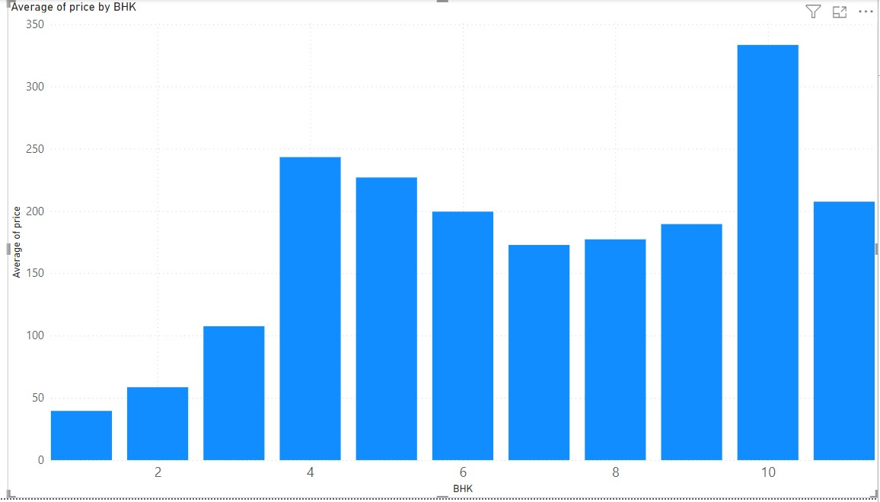
BHK
As the no of bedrooms increases, the average price is also increasing.
For 4,5,6 and 10 bedroom houses the average price is high.

Slide 6
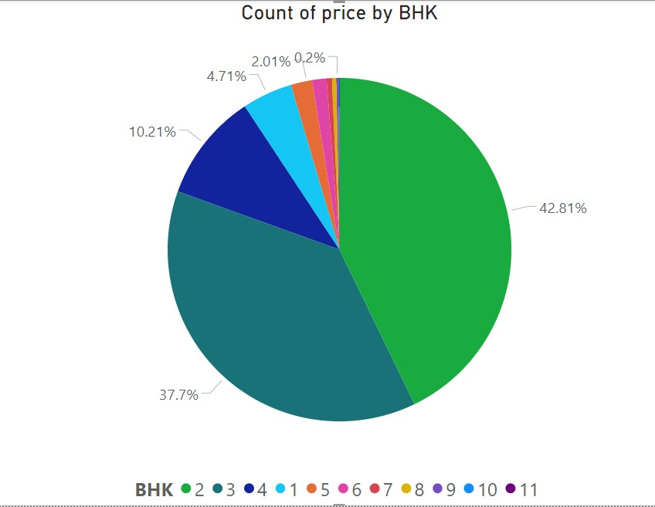
BHK
No of houses are more in 2 BHK and 3 BHK.
Approx. 43% are 2 BHK and 38% are 3 BHK.

Slide 7
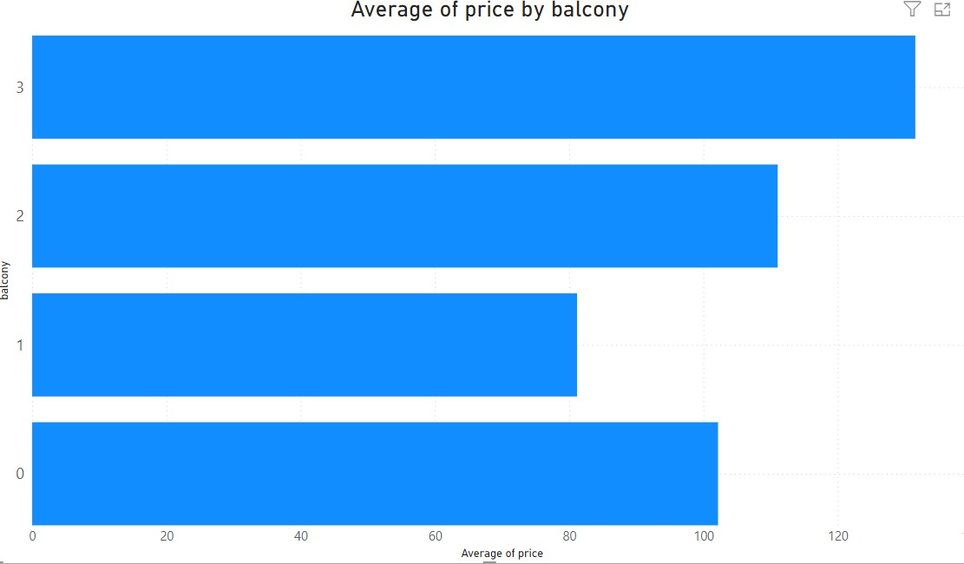
Balcony
For 3 Balcony average price is the highest.
As the no of balcony is increasing the average price is also increasing.

Slide 8
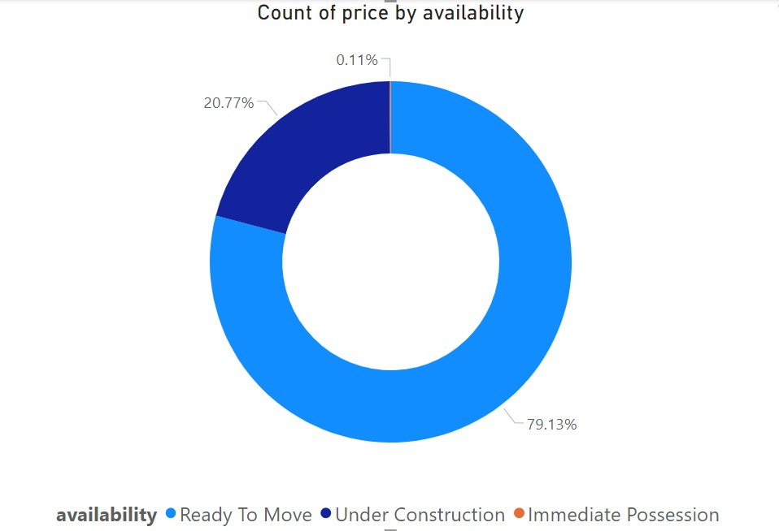
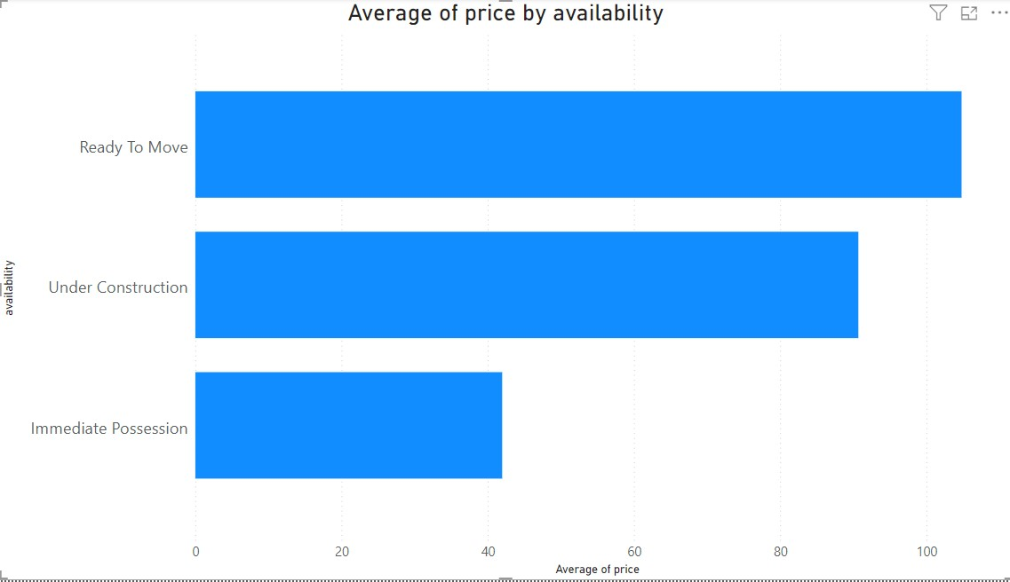
Availability
Mostly houses are ready to move
Ready to move are costly

Slide 9
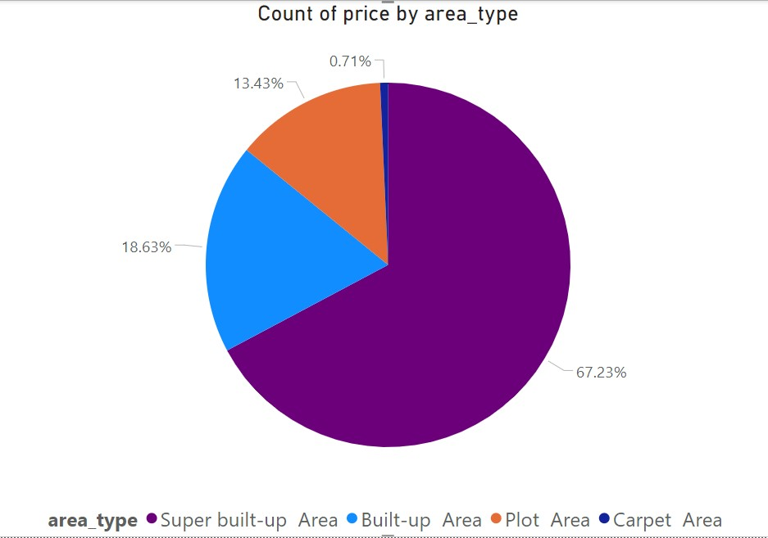
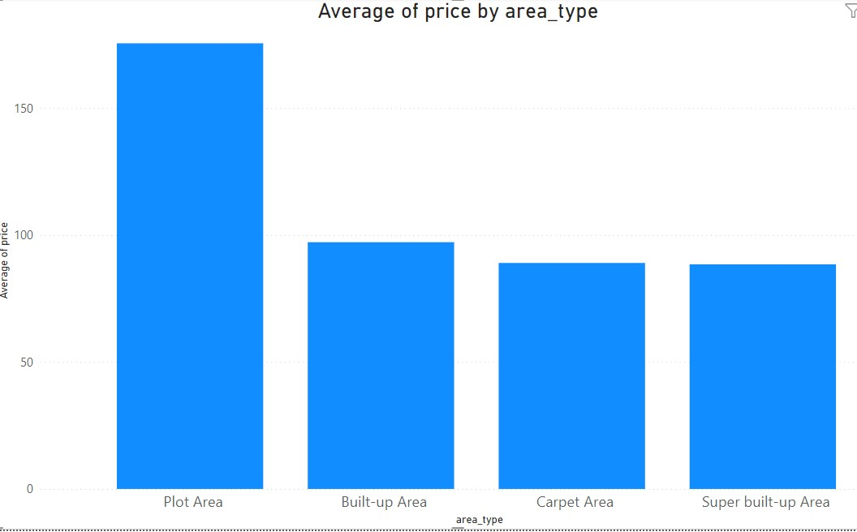
Area Type
67% are in super built up area
Houses in plot area are costly than others.

Slide 10
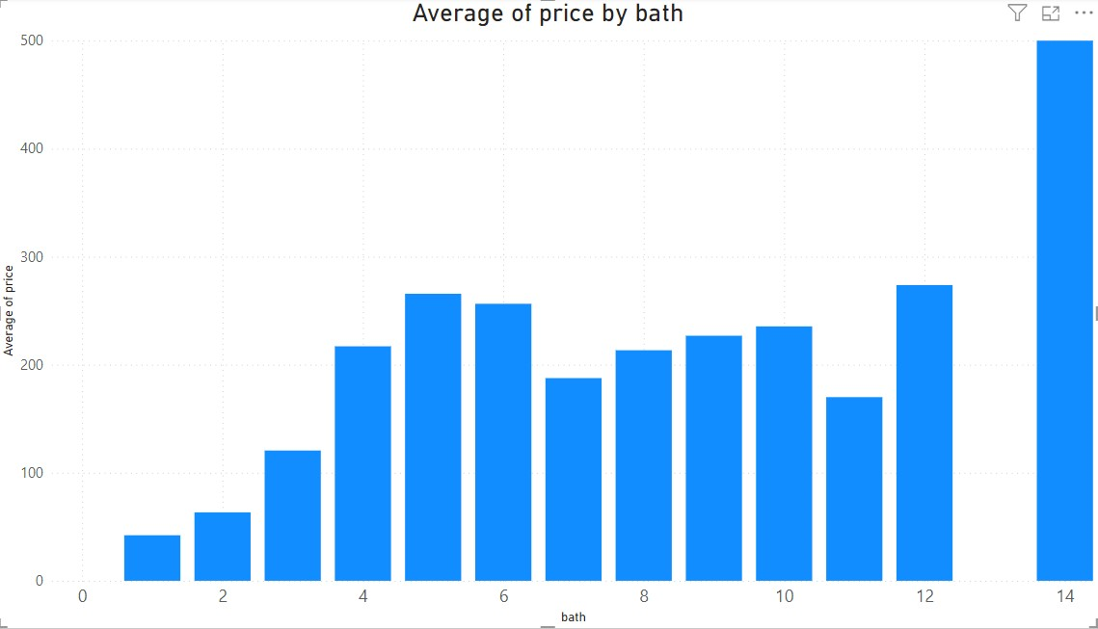
Bath
We can see as the no of bathroom increases average price also increases.

Slide 11
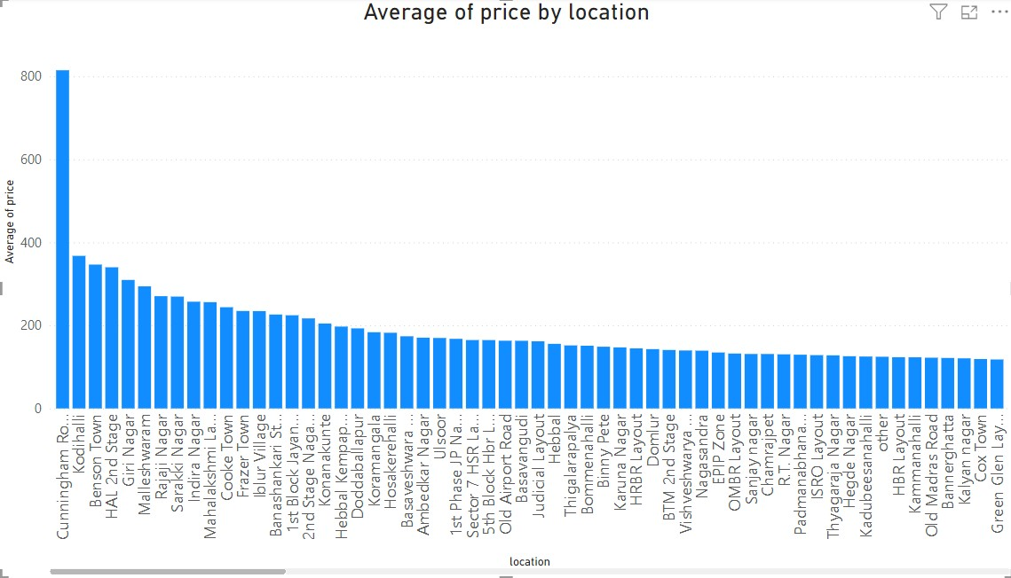
Location Cunningham Road is most costly

Slide 12
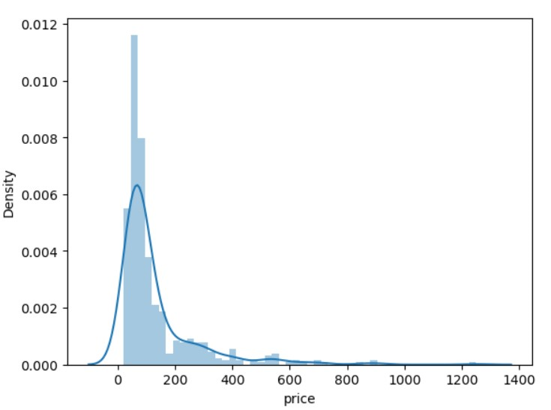
Price
When seeing locationwise, price is positively skewed.

Slide 13
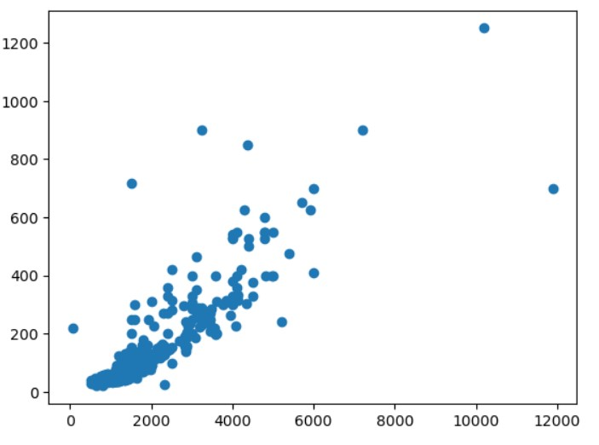
Price vs Area_sqfeet
For Location=‘Whitefield’:
X=Areasqfeet
Y=Price
Price is linearly related to Area_sqfeet locationwise.

Slide 14
Solution Process

Slide 15
About Dataset -
For accomplishing the project , data of house prices of India has been used.
It has 9 columns and 13,320 rows.
This dataset has features-
1. Numeric columns- Total_sqft,bath,balcony
2. Categorical columns- Area type, Availability, Location,size,society
3. Target column – Price

Slide 16
Preprocessing
1. Society column dropped as it ahs more than 40% null values.
2. Duplicated data dropped.
3. total_sqft and price is object instead of float/int datatype. So both the columns has been cleaned by removing null values, range values(123-789),units has been removed and totalsqft has been processed according to the units.
4. Location column has been processed and removed nan value. Locations having 10 or less than 10 houses has been assigned to ‘others’.
5. Outliers has been removed Location wise and BHK wise using IQRscore method.
6. In Availability column, the houses that are not ready has been assigned ‘Under Construction’.

Slide 17
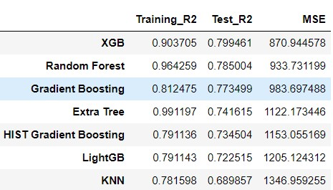
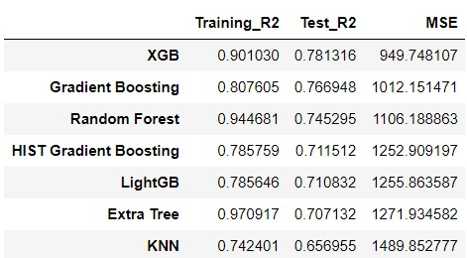
Model Comparison
Before selecting feature
After selecting features

Slide 18
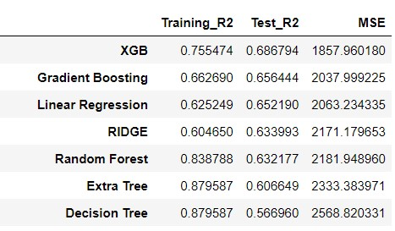
After Backward Elimination
Gradient Boosting and XGBoost
Are performing all the three cases.

Slide 19
Potential Benefits
1. We can use this ml model for prediction of house prices.
2. It can be used for locationwise price prediction.
3. As per features required we can use feature selection and use the optimum model.

